Slide 1
Peripherals/Computer Connections
The CPU performs arithmetic and logic operations and controls the operation of the entire system.
Some tasks are completely controlled by CPU, but for some others, it merely initiates a sequence of events which are controlled elsewhere, such as in a peripheral device.
The peripheral devices permit communication of information and storage of information.

Slide 2
Peripherals/Computer Connections(Cont..)
Peripherals normally communicate through the CPU.
Some may communicate themselves and memory bypassing CPU
The number and types of peripheral devices depend on the main applications for which the computer system is intended.

Slide 3
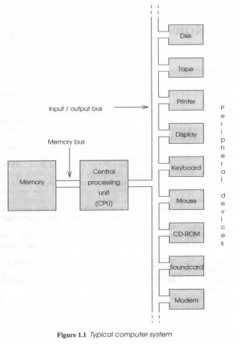
Typical Computer System
Excluding CPU and Memory
all other Input Output
connected with the
computer systems altogether
referred to as peripheral
devices

Slide 4
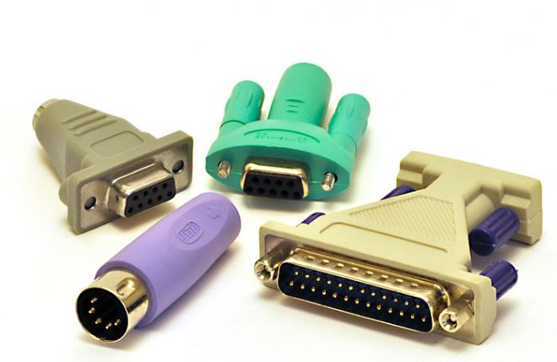
Peripheral Adapter
Modern computers perform operations very much faster than most peripherals can generate or accept data.Programs and data are moved between memory and the CPU at such a speed that it would be inappropriate to connect peripherals directly to the CPU. So some form of interface (Peripheral Adapter) is required to convert between the fast internal communications and the relatively slow external devices.

Slide 5
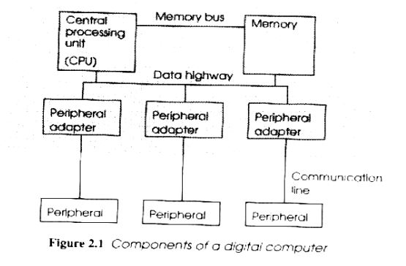
Peripheral Adapter (Cont..)
A peripheral adaptor works as an interface between CPU (very fast) and a peripheral device (relatively slow) for data communication.

Slide 6
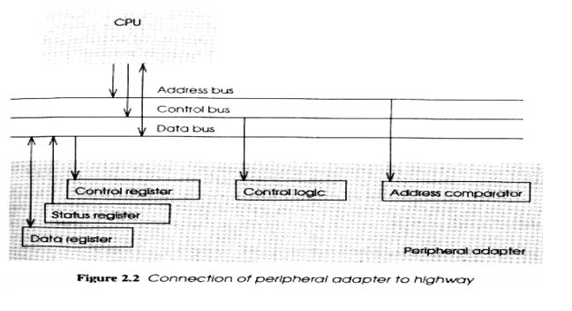
PA Registers(Cont..)
Peripheral adaptors are directly connected to the buses. PA contains: Control register,Status register, Data register,Control Logic, Address Comparator.

Slide 7
PA Registers(Cont..)
Address Comparator
-It is necessary to distinguish between adapters used for different peripherals.So a value is allocated to the adaptor (Often set with switches).
-An adaptor may recognize a single address or a small group of address.
-It compares the address on the address bus with the peripheral adapter’s address.
-If the address on the bus matches that of the adapter then the control lines are interpreted by the control logic to perform the required function, typically to read from or write to a register (may be data register) connected to a data bus.

Slide 8
PA Registers(Cont..)
Control Register
Stores values written to it to control the operation of the adaptor.
Status Register
-Can be read by the CPU to determine the status of the device (e.g. whether it is ready for use, busy, switched on/off etc.)
-Each piece of information stored in the control and status registers usually needs only a single bit and several such bits are stored in each register, each bit is often known as a flag.

Slide 9
PA Registers(Cont..)
Data Register
Used to hold temporarily a value to be transferred to or from the peripheral so that it is not necessary to synchronize the computer with the peripheral

Slide 10
END..

